Slide 1
Machine Learning Chess
Peter Flockhart and Henry Johnson
CS 542

Slide 2
Introduction
Chess is one of the world’s oldest games, with records of the game predating the 7th century CE.
The study of chess is rooted in psychology, game theory, and probability. It has a game complexity tree of 10^(120), the Shannon number.
Finding the best move requires split-second critical thinking and analyzation, efficiency, and a knowledge of what comes ahead and what has past. You must build off of what you have done or seen before to be successful.
Machine learning allows us to solve complex problems in a much simpler way through the development of quick, deep learning and neural networks. We leave the hard work up to the machine; all we have to do is build it.

Slide 3
Data Sets
Where is the data from?
Chess games from the 1800s to now are widely available online for free.
What is the data?
Chess games parsed and formatted to their move lists; additional game info such as players and event discarded
Sample size
So much data, such little time
Time constraints (due to data evaluation and cleaning) limited our training data to roughly 200,000 samples, much less than the ideal 1-10 million samples we wanted.

Slide 4
Neural Network
Constructed using Keras Sequential model on top of TensorFlow.
Library for simplification of neural network building
Supervised learning
Expected/desired outputs for the data was given to train on
Two models
Model 1: Piece Count
4 hidden layers, 1 activation layer, 1 dropout layer
Uses stochastic gradient descent with a .01 learning rate and .002 learning rate decay each epoch
Model 2: Piece Position
5 hidden layers, 1 activation layer, 2 dropout layers
Uses RMSProp with a .1 learning rate and .002 learning rate decay each epoch

Slide 5
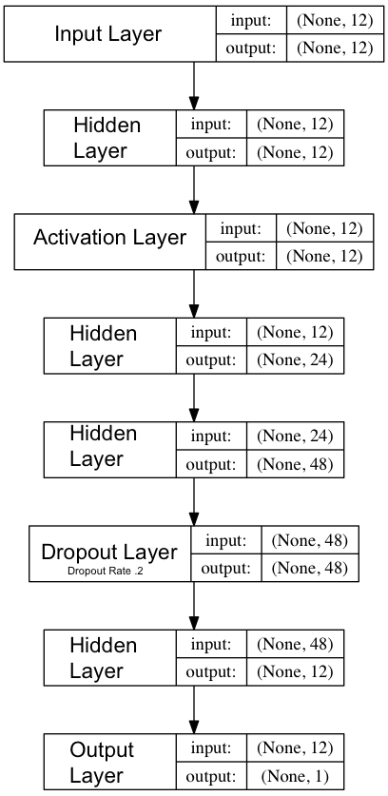
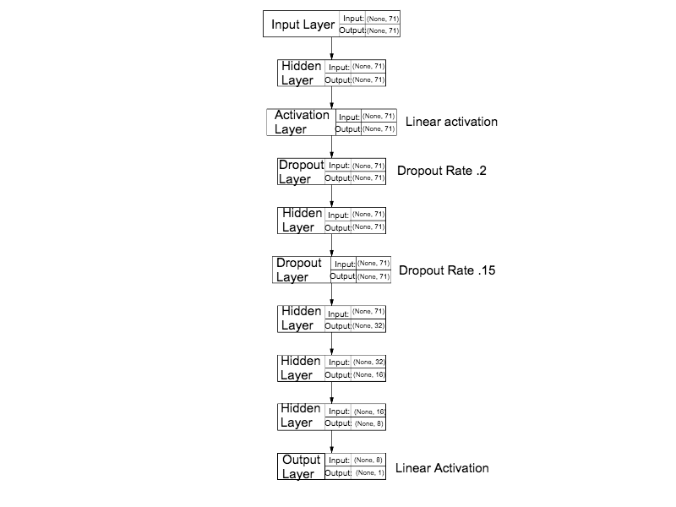
Structure
Note: Unless otherwise stated, the activation function of each layer is tanh.
Stochastic Gradient Descent
LR: .01, Decay: .002
RMSProp
LR: .1, Decay: .002
Model 1: Piece Count
Model 2: Piece Position

Slide 6
Input
Model 1: Piece Count
12 nodes
Each node represents the number of each type of piece on the board.
e.g. 1 black king, 2 white rooks, etc
Model 2: Piece Position
71 nodes
First 64 nodes represent each square of the board with a value corresponding to the piece at that location
Last 5 nodes represent castling rights, check/checkmate, and the turn

Slide 7
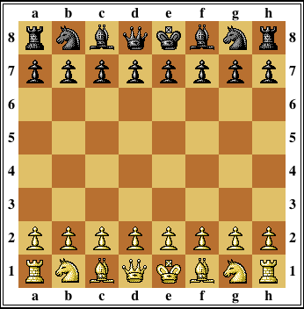
Board/Input
Visualization of Model 2 input on a chess board
EPD: rnbqkbnr/pppppppp/0/0/0/0/PPPPPPPP/RNBQKBNR w

Slide 8
Output
Output: Evaluation of chess board
Use tanh activation required output scaling between -1 and 1.
Best Move: Move with max/min score on chess board
Closer to -1 good for black, closer to 1 good for white

Slide 9
Evaluation
Metrics for success (testing against traditional chess engine):
Time: How quickly can the model make predictions?
Accuracy: What percent of the time is the best move picked?

Slide 10
Metric: Time (Both Models)
One position in 3 millionths of a second.
Much faster than a traditional chess engine.
High accuracy per unit time

Slide 11
Metric: Accuracy, Piece Count
Best Move Prediction is ~three and a half times as good as random guessing (average 7%).
Best Move in Top Three Prediction has average of 18%, just over twice as much as Best Move.
Drop off with layer reduction.
Most effective model had 5 hidden layers

Slide 12
Metric: Accuracy, Piece Position
Best Move Prediction is two times as good as random guessing (average 4.5%).
Best Move in Top Three Prediction has average of 10.66%, twice as much as Best Move.

Slide 13
Metric: Accuracy
Note: Error of model is only relevant among many samples, not just one because you need to know strength of a position relative to other positions.
Note: Out of 50 possible chess moves per turn, picking one at random to play is 1/50, or 2%. Our model gives us the best move (highest/lowest score depending on player/turn) 3.5 times that of random

Slide 14
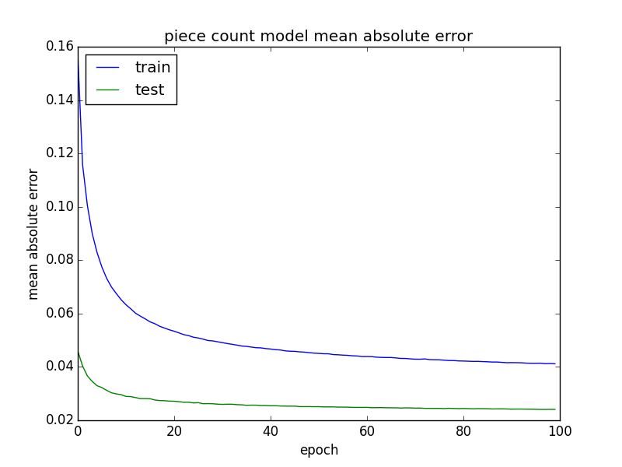
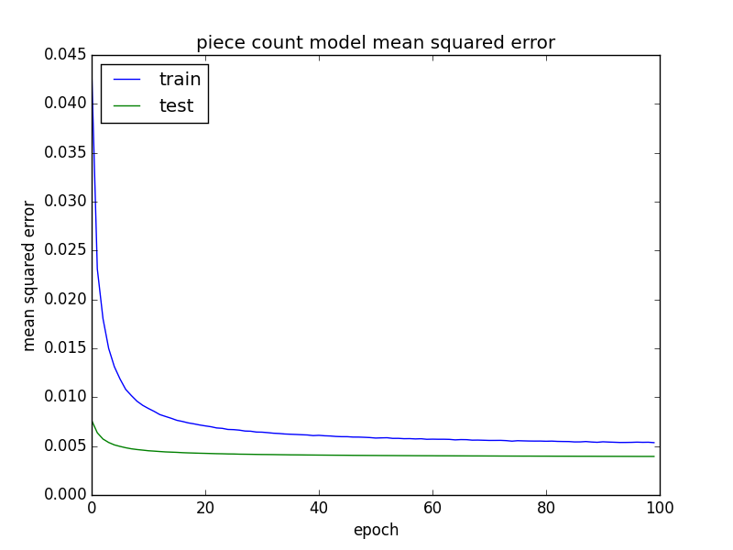
Evaluation: Model 1, Piece Count Graphs

Slide 15
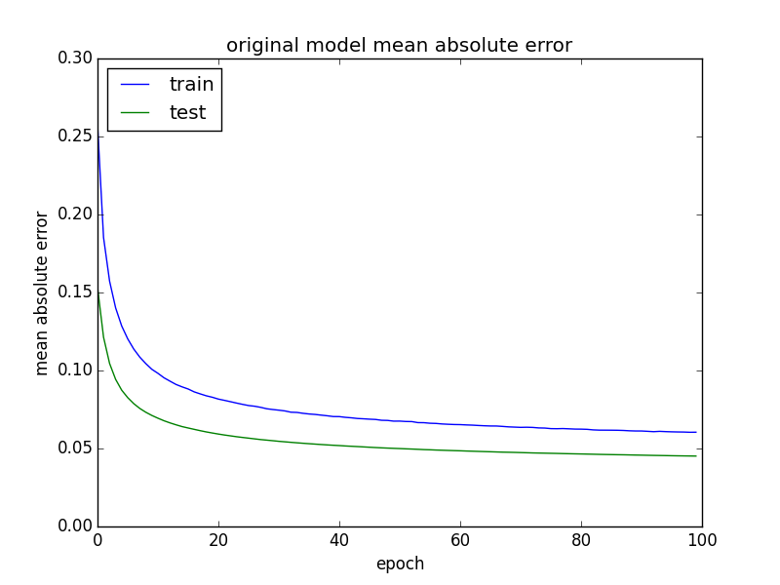
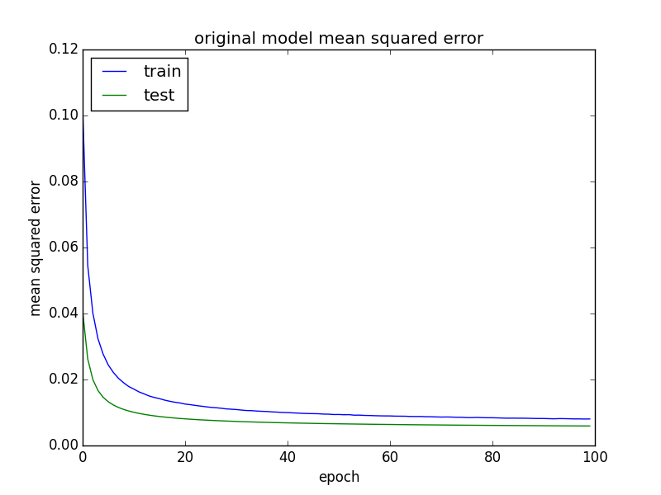
Evaluation: Model 2, Piece Position Graphs

Slide 16
Conclusion and Further Work
As Model 1 provides the best output, the focus of further project developments will be done on Model 1.
While accuracy per time is good, and the Best Move rate at ~7% for model one is acceptable, the Top 3 at <20% is not ideal, and further work could be done to remedy this problem, as outlined below.
Improvement of Data: Increase evaluation time to >1 second for better testing data.
Improvement of Accuracy Metric: Use of a bigger data set on the model and possible longer model runtime, along with reinforcement learning, to produce better accuracy.
Reinforcement learning: Feed results of test into the model to increase accuracy and develop a “smarter” machine; finer-tuned results and understanding of chess theory/rules.
Testing outputs during live chess game to see if an advantage is had, resulting in better win/loss ratio.

Slide 17
Contributions
Peter Flockhart:
Model coding and testing, finding data and generating
Henry Johnson:
Model testing, report and presentation, finding data

